Slide 1
신경과의 말초신경근육 질환
노원을지병원 신경과
유일한

Slide 2






Ann Romney, wife of former presidential contender Mitt Romney
Amyotrophic lateral sclerosis (ALS)
https://alstreatment.com/famous-people-with-als/
https://neuronup.us/cognitive-stimulation-news/acquired-brain-injury/stroke/celebrities-with-neurological-and-mental-disorders/
https://www.webmd.com/multiple-sclerosis/ss/slideshow-faces-of-ms

Slide 3
신경과의 말초신경 근육질환 파트에서 보는 질환
Central nervous system (CNS) demyelinating disease
Multiple sclerosis (MS)
Neuromyelitis optica spectrum disorder (NMOSD)
etc.
Spinal cord disease (myelopathy)
Peripheral nerve disorders
Neuromuscular junction disorders
Muscle disorders

Slide 4
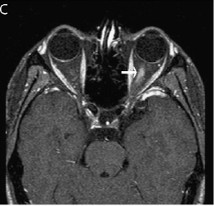
Case 1
21 year old, woman
vision loss 5 days ago in right eye, gradual onset, progression
Periocular pain worsened by eye movement.
right relative afferent pupillary defect (RAPD), visual acuity of 20/70 in right eye.

Slide 5
Multiple sclerosis
Massimo Filippi, 2018

Slide 6
MS
NMO
Ho-jin Kim, 2015

Slide 7
Case 2
A 30-year-old woman with 6-month history of bilateral ptosis, diplopia, intermittent mild dysphagia, neck heaviness
Creatine kinase level: normal
Acetylcholine receptor (Ach), muscle-specific tyrosine kinase antibodies: (-)
Repetitive nerve stimulation test: normal
Single-fiber EMG of frontalis: abnormally increased jitter with increased fiber density
Pyridostigmine treatment: improvement
Michael W. Nicolle, 2016

Slide 8
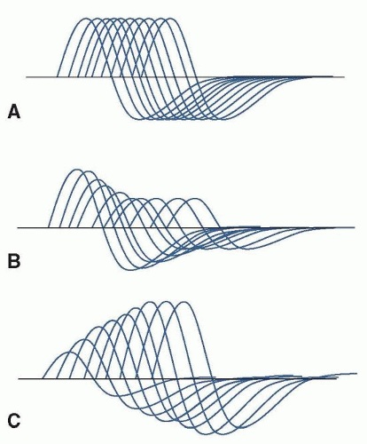
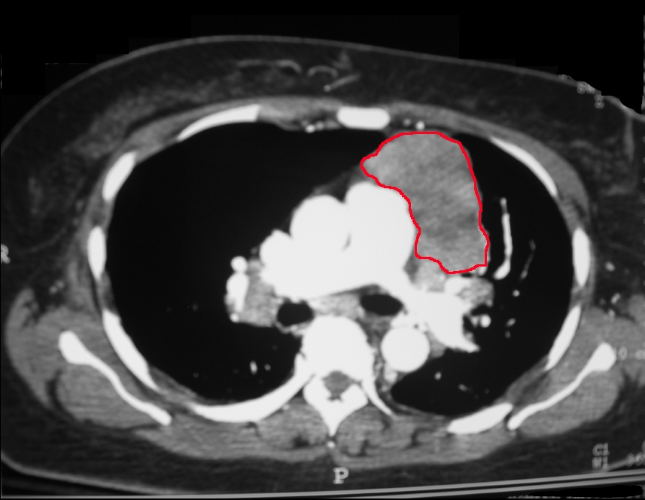
Myasthenia gravis
Weakness increase with repetitive use, day
progress.
Diplopia, ptosis, dysarthria, dysphagia
Repetitive nerve stimulation test
Acetylcholine receptor antibody, muscle-specific tyrosine kinase antibody
Pyridostigmine and immunosuppressive drugs
Thymectomy
Nils Erik Gilhus, 2019
https://en.wikipedia.org/wiki/Thymoma#/media/File:Anterior_mediastinal_mass_thymoma_diagram.jpg
https://neupsykey.com/myasthenia-gravis-and-disorders-of-the-neuromuscular-junction/

Slide 9
Emma Ciafaloni, 2019

Slide 10
Case 3
A 67-year-old man, 8-month history of progressive slurring of speech
Weakness of left hand without numbness
Muscle cramping in his hands and legs
Cry spontaneously (unusual for him)
Neurologic exam
spastic and flaccid dysarthria
fasciculation of tongue, arms, thighs
Atrophy of tongue and left hand
Arm and leg reflexes were brisk.
Extensor plantar response, positive Hoffman sign
Brain MRI, spine MRI: unremarkable
Needle EMG: fibrillation and positive sharp waves in hand muscles, leg muscles, thoracic paraspinal muscles.
Colin Quinn, 2020

Slide 11
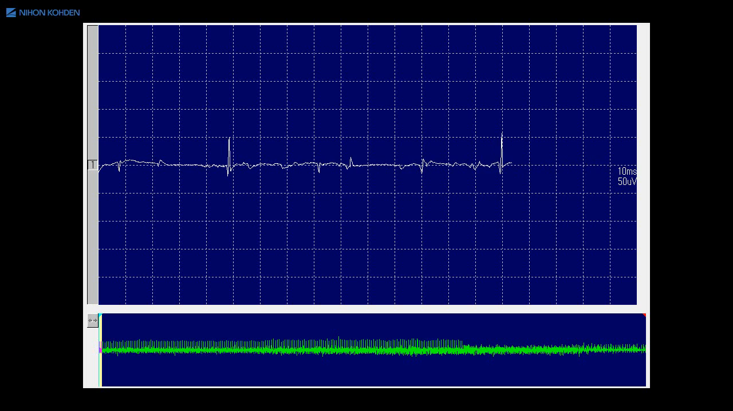
Amyotrophic lateral sclerosis
https://www.youtube.com/watch?v=9W_JmkotwQs
Orla Hardiman, 2017

Slide 12
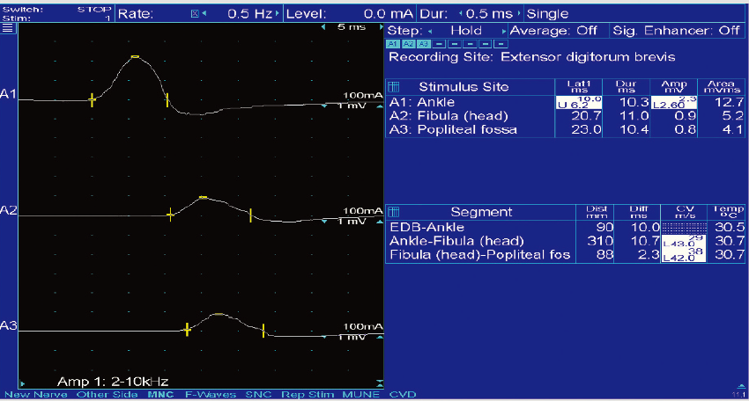
Case 4
A 36-year-old woman, proximal greater than distal weakness in legs.
Areflexia, distal sensory loss, dyspnea
Preceding diarrhea
Nerve conduction study (NCS): sensorimotor polyneuropathy
Cerebrospinal fluid (CSF) analysis: white blood cells 0, elevated protein
Peter D. Donofrio, 2017

Slide 13
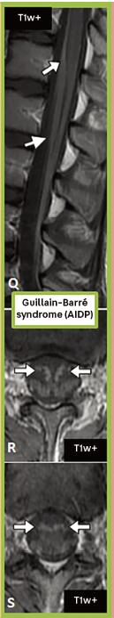
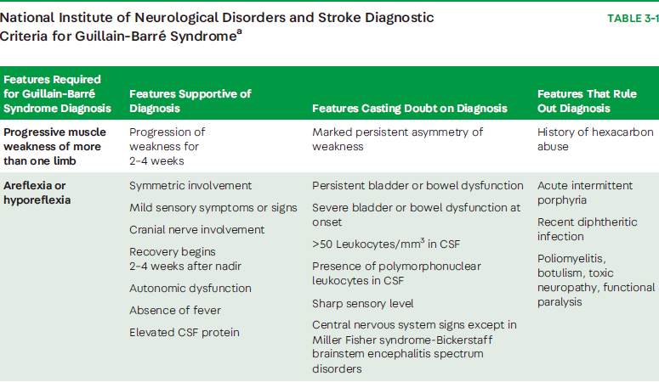
Guillain-Barré Syndrome
Kazim A. Sheikh, 2020
Hugh J Willison, 2016
Felix E. Diehn, 2021

Slide 14
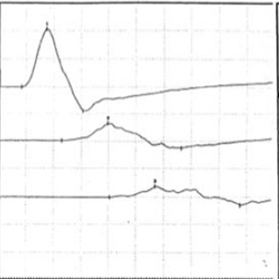
Case 5
A 65-year-old man, 1 year of progressive upper and lower extremity weakness
require a cane to ambulate, decline in manual dexterity with difficulty buttoning shirts and gardening.
Dysarthria, dysphagia, dyspnea: denied.
CSF analysis: WBC 1, protein 661 mg/dL
NCS: sensorimotor polyneuropathy with
conduction block, temporal dispersion in motor NCS
Mark B. Bromberg, 2013

Slide 15
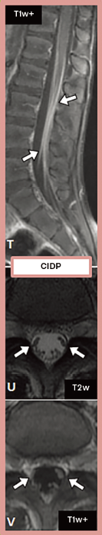
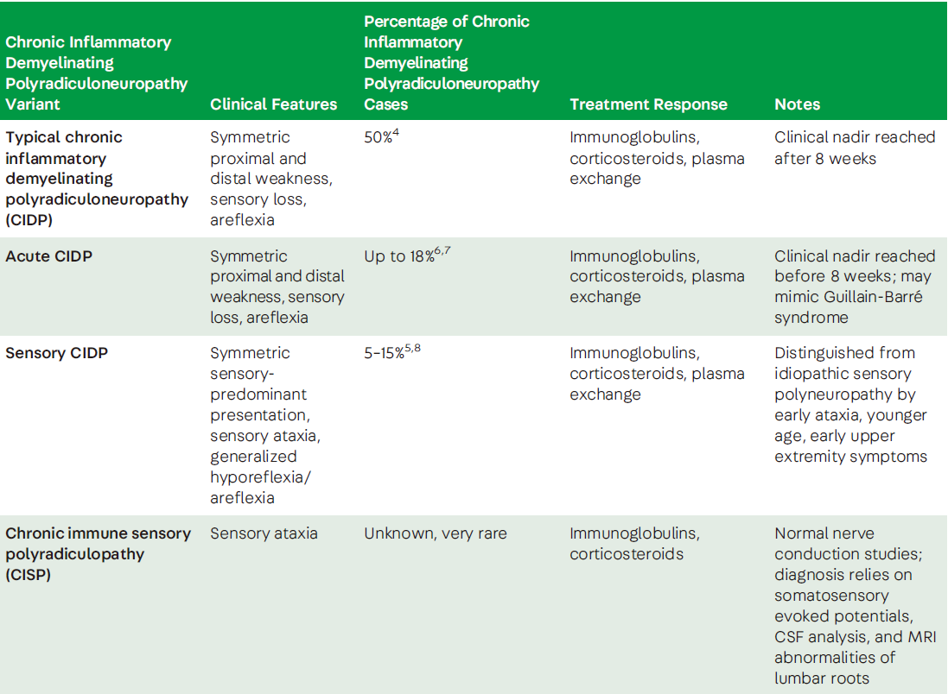
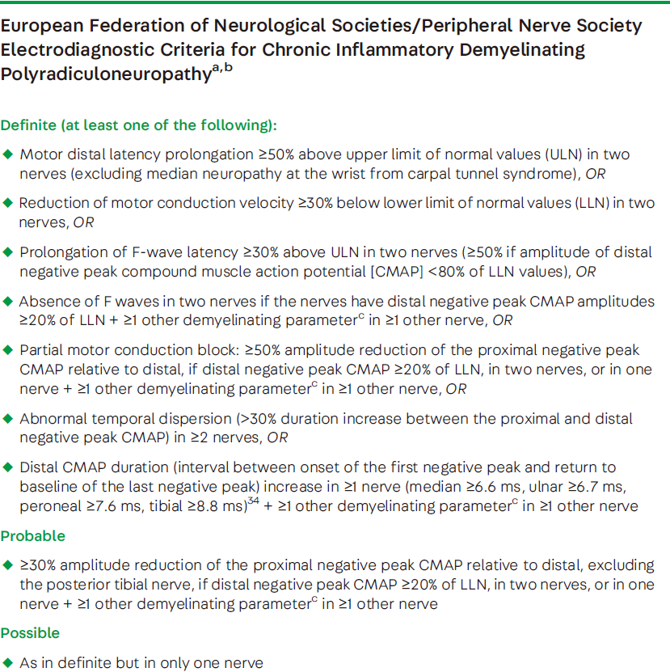
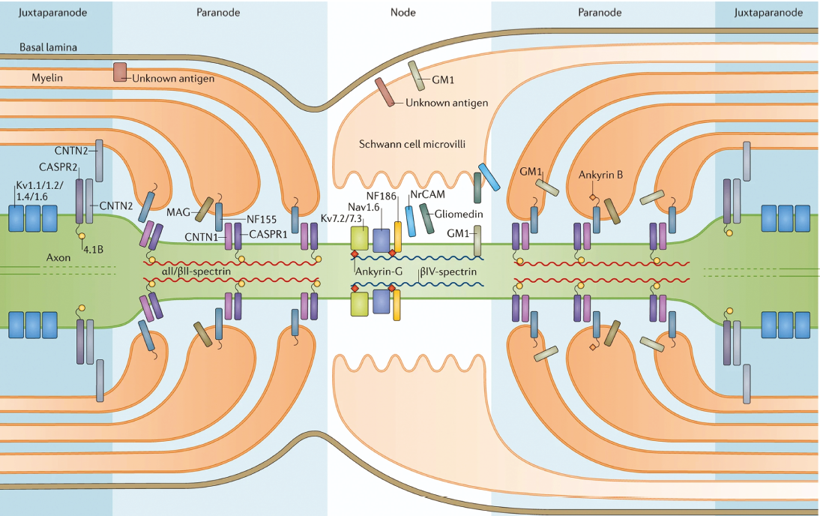
Chronic Inflammatory Demyelinating Polyradiculoneuropathy (CIDP)
Kelly Gwathmey, 2020
Felix E. Diehn, 2021

Slide 16
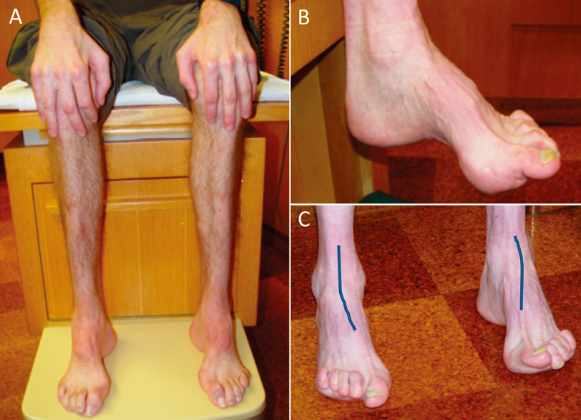
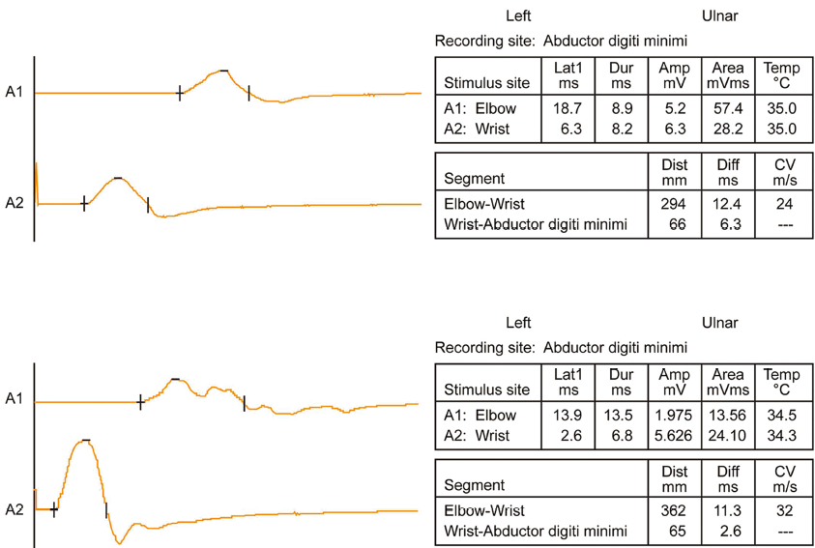
Case 6
A 24-year-old man, tripping episode.
Marked high arches and hammering of toes
Inverted champagne bottle legs
Steppage gait with distal weakness
NCS: conduction velocity slowing without
temporal dispersion.
Christopher J. Klein, 2020

Slide 17
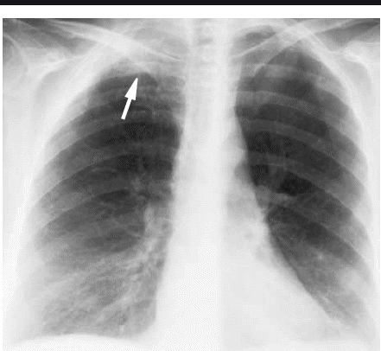
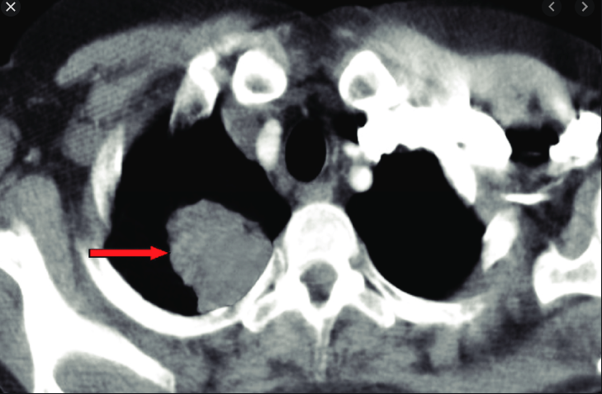
Case 7
A 47-year-old man, right shoulder pain, paresthesia along the medial aspect of arm
Grip-strength loss
Right-side Horner syndrome, right forearm and hand muscle weakness and atrophy, sensory loss along the medial aspects of the right arm, forearm, hand
NCS/EMG (electromyography): abnormal result in right medial antebrachial and ulnar sensory, median and ulnar motor NCS, fibrillations and neurogenic recruitment in abductor pollicis brevis, abductor digiti minimi muscles.
http://www.aboutcancer.com/pancoast.htm
https://www.researchgate.net/figure/Pancoast-tumor-located-in-the-posterior-component-posterior-Pancoast-tumor_fig6_221924894

Slide 18
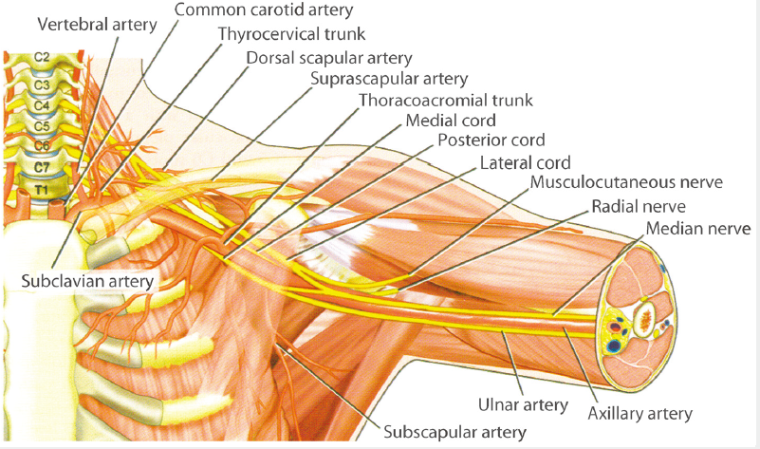
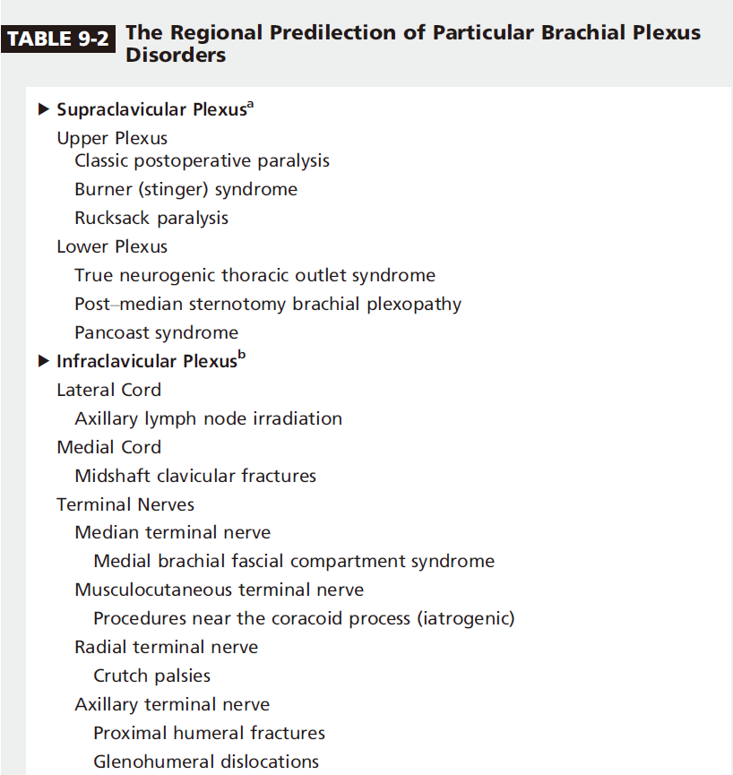
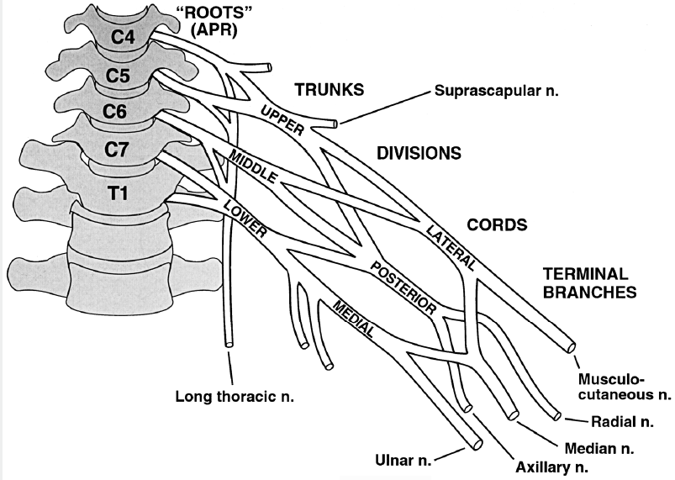
Brachial plexopathy
Mark A. Ferrante, 2014

Slide 19
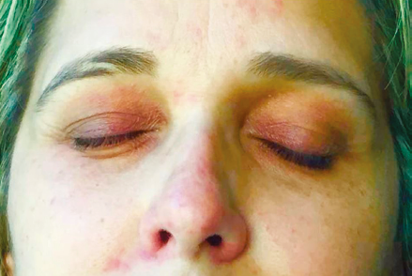
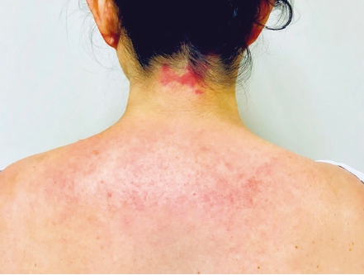
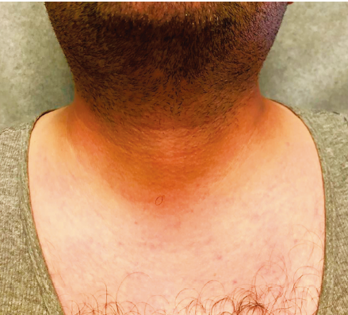
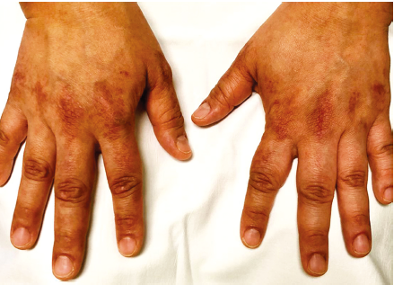
Case 8
A 57-year-old woman, 2-3 months of mild proximal weakness of her legs and arms.
Myalgia, fatigue, weight loss, arthralgia, erythema on her face
Erythematous skin change on her scalp, face, eyelid, anterior neck, elbow, metacarpophalangeal joints.
Weakness of neck flexor, shoulder, hip flexor, knee extensor muscles.
Creatine kinase level: 389
EMG: fibrillation potentials, short duration and low amplitude motor unit potentials.
Namita A. Goyal, 2019

Slide 20
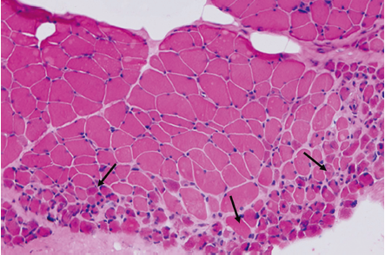
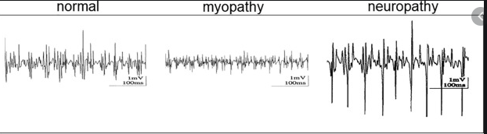
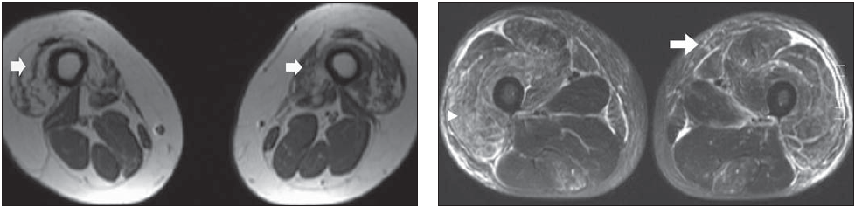
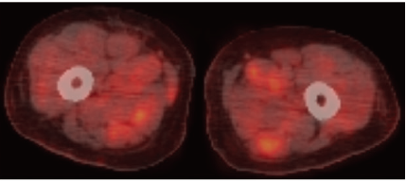
DERMATOMYOSITIS
Erik Stålberg, 2019
Namita A. Goyal, 2019
Maximilian Schulze, 2009
Edward Smitaman, 2018

